Slide 1
Cultural Adjustment

Slide 2
What is “Culture Shock?”
DEFINITION
“The feeling of disorientation experienced by someone who is suddenly subjected to an unfamiliar culture, way of life, or set of attitudes.”
THE SYMPTOMS
Sadness/homesickness
Feeling isolated & lonely
Irritability/frustration
Anxiety and/or trouble sleeping
Trouble concentrating
Lack of desire to meet new people or learn about new culture
Binge eating or loss of appetite
When you move to a new place, you’re bound to face a lot of changes. It’s natural to have difficulty adjusting to a new culture, but the good news is that culture shock is temporary.

Slide 3
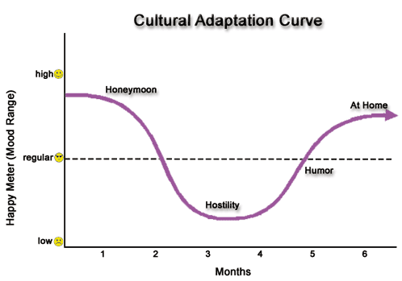
How It Works
Notes:
Honeymoon – fascinated and excited by everything Culture Shock – Challenges rise to the surface with language, food, housing, transportation, making friends…
Begin feeling especially lonely, missing native language and culture, frustrated that people don’t seem to understand you, can’t always express yourself the way you want Adjustment Stage – Living with new roommates and going to school becomes easier, English language skills improve, become more self-confident, settle into your new routine
Acceptance/Integration – start to truly accept all the habits, customs, food, and characteristics of the people in your new culture. Generally feel more comfortable in your new surroundings

Slide 4
Cultural Adjustment Cycle
Honeymoon - Initially, you are fascinated and excited by everything new. You feel elated to be in a new culture and travel across the world!
Hostility – Challenges start to arise with housing, transportation, food, language, people, etc. You may experience fatigue, frustration, impatience, sadness, etc. However, these feelings are a good sign as it shows you are not just “skimming the surface” but engaging in the new culture.
Humor – Everyday activities are no longer major problems and you’ve settled into a routine. You feel more comfortable expressing yourself and find humor in “funny” situations.
Home – You’ve become accustomed to the habits, customs, food, language, people, and overall characteristics of the country, and appreciate the differences. You’ve found your second home!

Slide 5
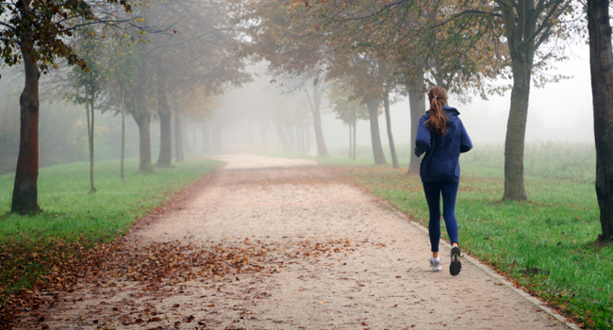
What can you do to minimize the shock?
Stay active and try new activities
Familiarize yourself with your surroundings
Engage with local people
Go to events where you can meet new people!
Write in a journal
Keep in touch with friends & family back home
Be slow to judge
Don’t be afraid to ask questions
Take time to study German culture, customs, & history
When observing situations, compare behavior with your home country

Slide 6
And remember… Keep an open mind!
https://www.youtube.com/watch?v=84OT0NLlqfM

